Slide 1

VBPD
Crime Analysis
Source: https://data.virginiabeach.gov/datasets/67bc708103e746f18e216c32ba39febe_0/explor

Slide 2
Data
# Introduction
Crime analysis is a crucial aspect of law enforcement and public safety. This project focuses on analyzing crime data to derive insights into patterns, trends, and factors influencing criminal activities. By leveraging data-driven approaches, we aim to enhance understanding and inform strategies for crime prevention.
# Problem Statement
The primary objective is to utilize crime data to identify key patterns and trends. This involves answering specific questions related to crime distribution, zone-specific incidents, and addressing systemic issues in specific areas.
# Data Source
The dataset used in this project contains detailed information about police incident reports, including offense descriptions, zones, addresses, and timestamps. Data Source : https://data.virginiabeach.gov/ VB Police Department
# Overview
This Python script conducts a thorough analysis of crime data sourced from the "Police_Incident_Reports.csv" file. The analysis addresses key questions related to Part 1 offenses, Zone-specific incidents, and address block patterns, specifically in the first half of the years 2021 to 2023.
Data pulled 11/29/2023

Slide 3
Goals
What are the Top 10 Part 1 offenses (as defined by the FBI’s UCR reporting standards) for the first half of each year by total count from 2021 to 2023? Use a total cumulation of all years to establish the Top 10.
What Zone had the most incidents for that crime type in the first half of 2023? Is this Top Zone trending up or down comparative to previous years?
What are the Top 10 address blocks with the most incidents in the first half of 2023? Is the top block segment a systemic problem or was this an outlier?

Slide 4
Top 10 Part 1 offenses for the first half of each year by total count from 2021 to 2023
LARCENY, FROM MOTOR VEHICLE 3705
ASSAULT, SIMPLE 3520
HIT & RUN 3462
DESTRUCTION OF PROPERTY, PRIVATE PROPERTY 3392
ASSAULT, SIMPLE, DOMESTIC 2965
LARCENY, ALL OTHERS 2322
DRUG/ NARCOTIC VIOLATIONS 2256
LARCENY, SHOPLIFTING 2129
WEAPON LAW VIOLATIONS 1257
MOTOR VEHICLE THEFT 1243
Chart below showing the count of offenses for each year classified by the offense type .

Slide 5
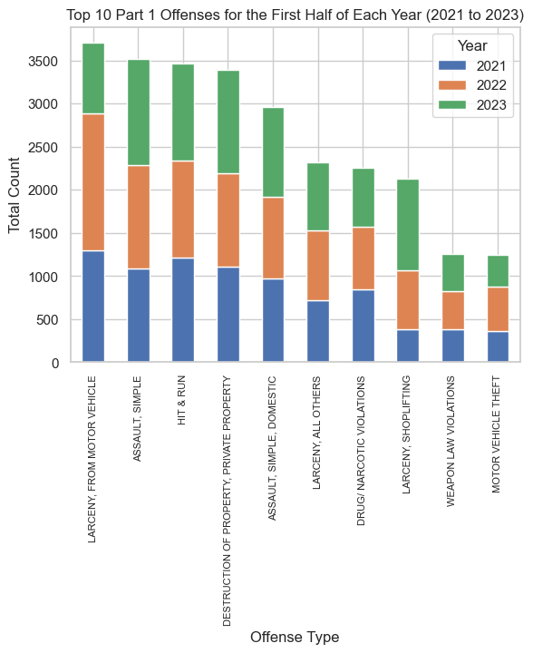

Slide 6
* What Zone had the most incidents for that crime type in the first half of 2023?
The Zone with the most LARCENY, FROM MOTOR VEHICLE incidents in the first half of 2023 is Zone 222.
Is this Top Zone trending up or down comparative to previous years?
The trend for Zone 222 compared to previous years is up.
- Chart below showing the Top 10 Zones with the Most LARCENY, FROM MOTOR VEHICLE Incidents (1st Half of 2023)
- Another chart present in details Incidents in Zone 222 (LARCENY, FROM MOTOR VEHICLE)

Slide 7
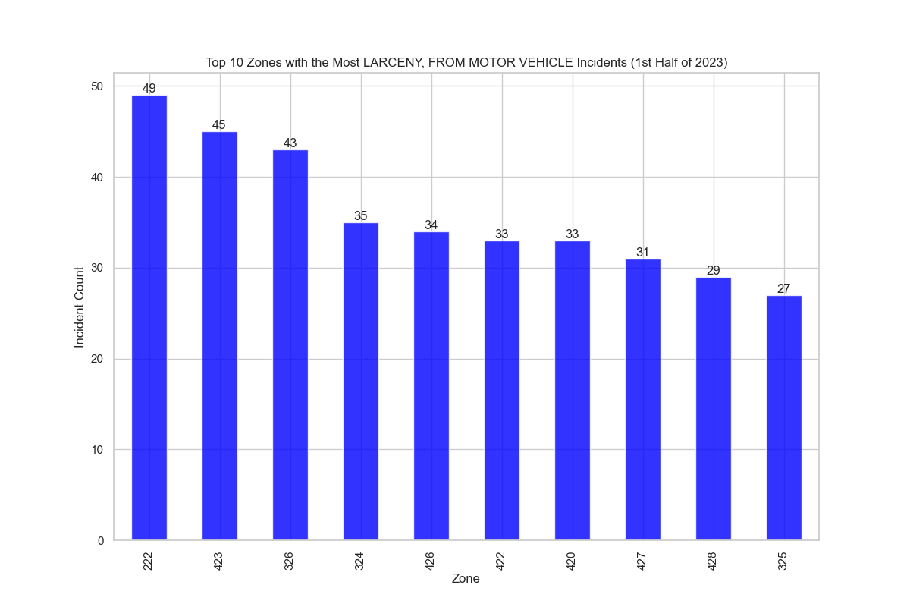

Slide 8
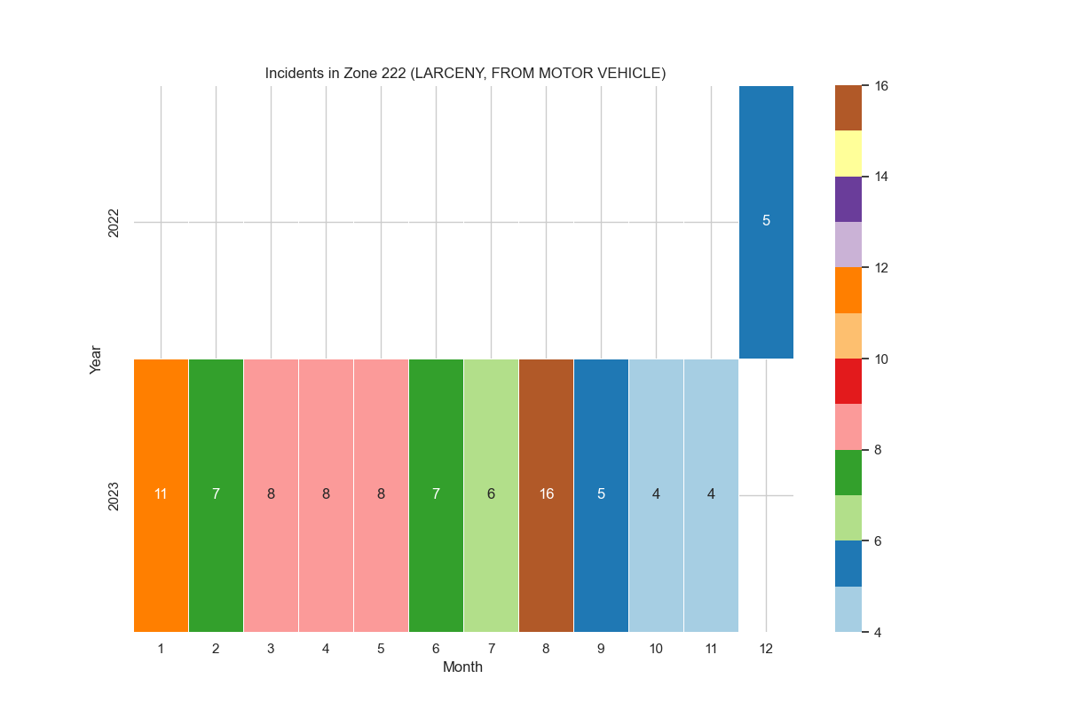

Slide 9
What are the Top 10 address blocks with the most incidents in the first half of 2023 in zone 222 ?
Top 10 Address Blocks with the most incidents in the first half of 2023 in Zone 222:
300.0 13
1900.0 7
1800.0 6
800.0 5
2400.0 4
400.0 3
500.0 3
2000.0 3
2300.0 2
700.0 2
Is the top block segment a systemic problem or was this an outlier?
The top address blocks in Zone 222 are not considered outliers.
It indicates that these blocks have a significantly different pattern of incidents compared to the overall pattern in Zone_ID 222 during the first half of 2023..
- Chart below showing Distribution of Incidents Across Blocks.
-Second Chart present Proportion of Incidents Across Top 10 Blocks

Slide 10
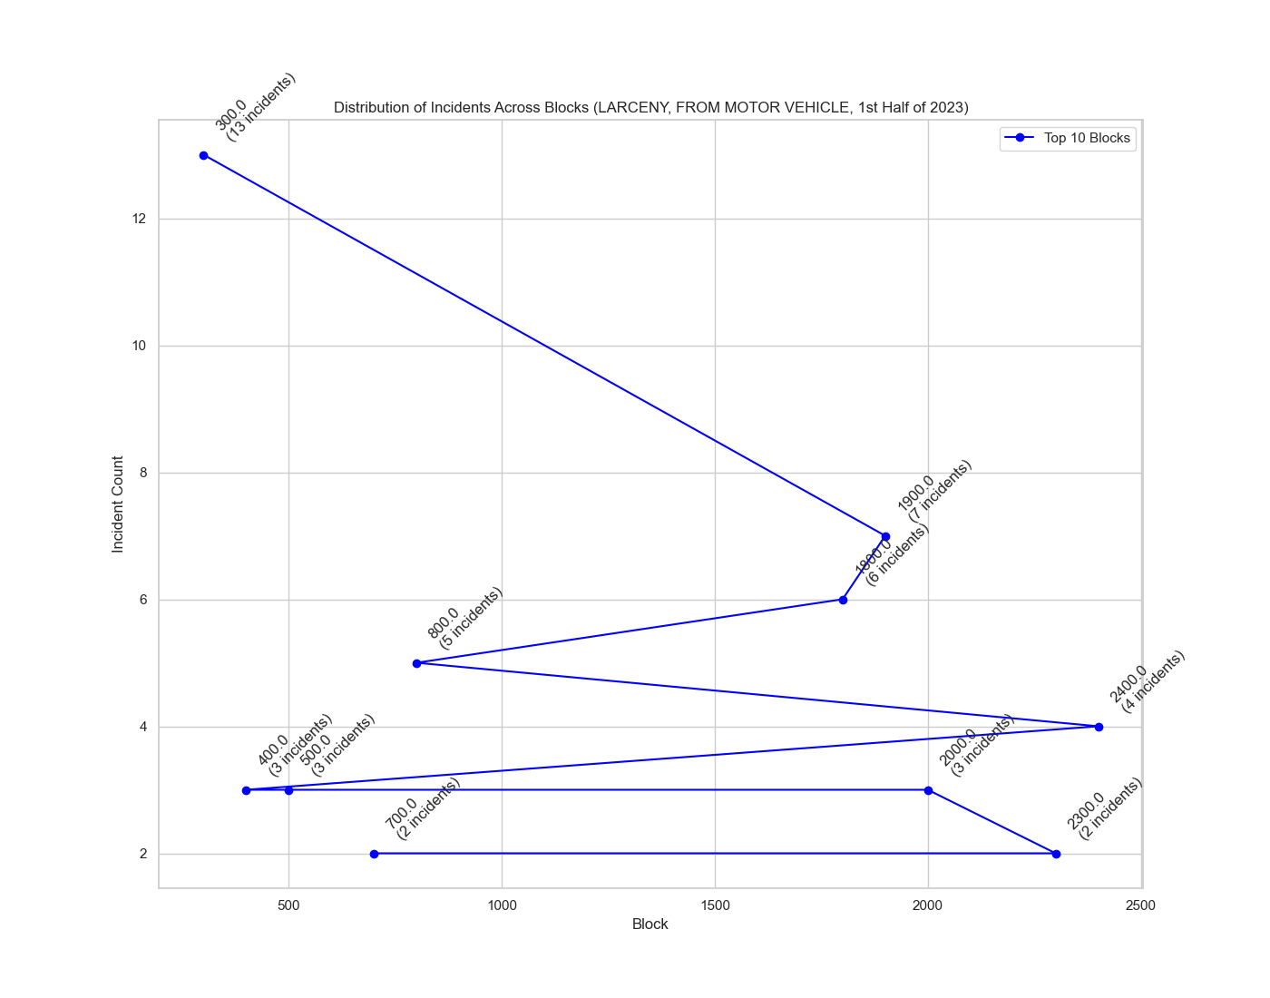

Slide 11
